Slide 1
Vrinda Store
Sales Report
BY Mohammed Afnan

Slide 2
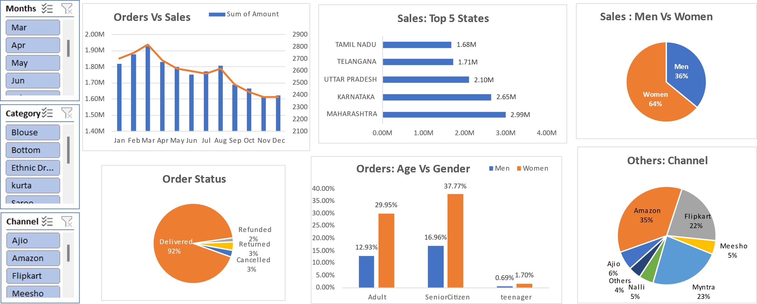
Sales Report By Following Year 2022
BY Mohammed Afnan

Slide 3
Order Vs Sales
Insights:-
The sales amount peaked in March, reaching its highest value of approximately ₹1.9 million. Orders also appear to peak around this time, suggesting a strong correlation between the number of orders and the sales amount.
After the peak in March, there is a noticeable decline in both sales amount and orders. The decline is gradual from April to September, with a sharper drop observed from September to October. This indicates a seasonal or possibly cyclical downturn in business during the latter half of the year
The sales amount and the number of orders show signs of stabilization in the last two months of the year (November and December). Although the values are lower compared to the first half of the year, the decline halts, indicating a possible leveling out of business activity towards the end of the year.
BY Mohammed Afnan

Slide 4
Sales : Top 5 States
Insights :-
Maharashtra has the highest sales among the top five states, with a sales amount of approximately ₹2.99 million. This indicates that Maharashtra is a significant market for the business, contributing the most to overall sales.
Karnataka and Uttar Pradesh have sales amounts of ₹ 2.65 million and ₹ 2.10 million, respectively, showing a strong performance. While there is a noticeable gap between Maharashtra and Karnataka, the competition between these states is relatively close, suggesting that these regions are also key markets.
Tamil Nadu and Telangana have the lowest sales amounts among the top five, with ₹ 1.68 million and ₹ ₹ 1.71 million, respectively. Although they are still significant contributors, their sales figures are considerably lower compared to Maharashtra and Karnataka, indicating potential areas for growth or need for targeted marketing strategies.
BY Mohammed Afnan

Slide 5
Sales : Men Vs Women
Insights:-
Women drive the majority of sales: With 64% of total sales, women are the primary customer base for this business.
Men represent a significant minority: While not the majority, men still contribute to a sizable portion of sales at 36%.
Target marketing opportunity: There's potential to increase overall sales by tailoring marketing and product offerings to appeal to both men and women, leveraging the insights into their purchasing behaviors.
BY Mohammed Afnan

Slide 6
Orders: Age Vs Gender
Insights:-
Adult women are the primary customer base: The chart demonstrates that the most significant portion of orders comes from adult women (32.46%), highlighting this segment as the core target audience.
Senior citizen women are the second-largest customer group: Senior citizen women constitute a substantial portion of orders (39.59%), indicating a significant market opportunity for products and services tailored to this demographic.
Teenagers and men represent smaller market segments: Teenagers and men across all age groups have relatively low order percentages, suggesting a potential for growth if marketing efforts are directed towards attracting these demographics.
BY Mohammed Afnan

Slide 7
Sales on Channel
Insights:-
Amazon Dominates the Market: Amazon is the clear leader in the market, capturing 35% of the total sales. This suggests a strong brand presence and customer preference for Amazon's platform.
Myntra and Flipkart are Strong Competitors: Myntra and Flipkart hold significant market shares of 25% and 21% respectively. This indicates a competitive landscape where these platforms are actively vying for customers.
Other Channels Have Growth Potential: The remaining channels, including Ajio, Nalli, Meesho, and Others, collectively account for 19% of the market share. While smaller, these channels present an opportunity for growth and expansion in the future.
BY Mohammed Afnan

Slide 8
Final Conclusion To Improve Vrinda Sales :-
Target Women Customers Of Age Group (30-49 yrs.) living in Maharashtra , Karnataka And Uttar Pradesh By Showing ads/offers/coupons Available on Amazon , Flipkart And Myntra
BY Mohammed Afnan

